Slide 1
Product Analysis Dashboard Inventory, Sales & Rating
Johnbosco Okoli

Slide 2
Dashboard Items:
KPI Cards: We have five KPI cards in display depicting the standout performance of certain important aspects.
Filters Section: Here we have an advanced toggle button which allows us to show or hide our filters. I have six filters in total applied to multiple sheets according to the understanding or my preference. i also can select multiple values at a go.
Worksheets: I have designed six different sheets to generate the most useful result for the client for all the different possible performance indicators.
URL: The dashboard also contains a URL action for the “Product Inventory Analysis for Merchants” worksheet, upon clicking which takes the user directly to the corresponding website.

Slide 3
:KPI Cards: (Without applying any filter)
The first KPI card tells us about the Total Sales for our client to be € 164,594,040.00, which signifies a descent number.
Interestingly the next card shows us the Total Profit generated to be a humongous €109,206,393.85, which in turn is 66.35% of the total sales value! That’s massive for our retail client.
Next one has identified the Merchant with the greatest number of products sold and it’s ‘primesalecolimited’ with as much as 120000 units sold of its products.
The penultimate card shows us the Product which generated the greatest number of sales and that is “Femmes dentelle plage boho maxi robe d'été sans manches robe longue fête vacances robes sans bretelles” with €5,000,000 total sales.
The final card shows the Product with the greatest number of five ratings. It is “Maillots de bain à rayures pour dames avec double débardeur tankini (plus grande taille)” with total 16,988 five ratings at the top.

Slide 4
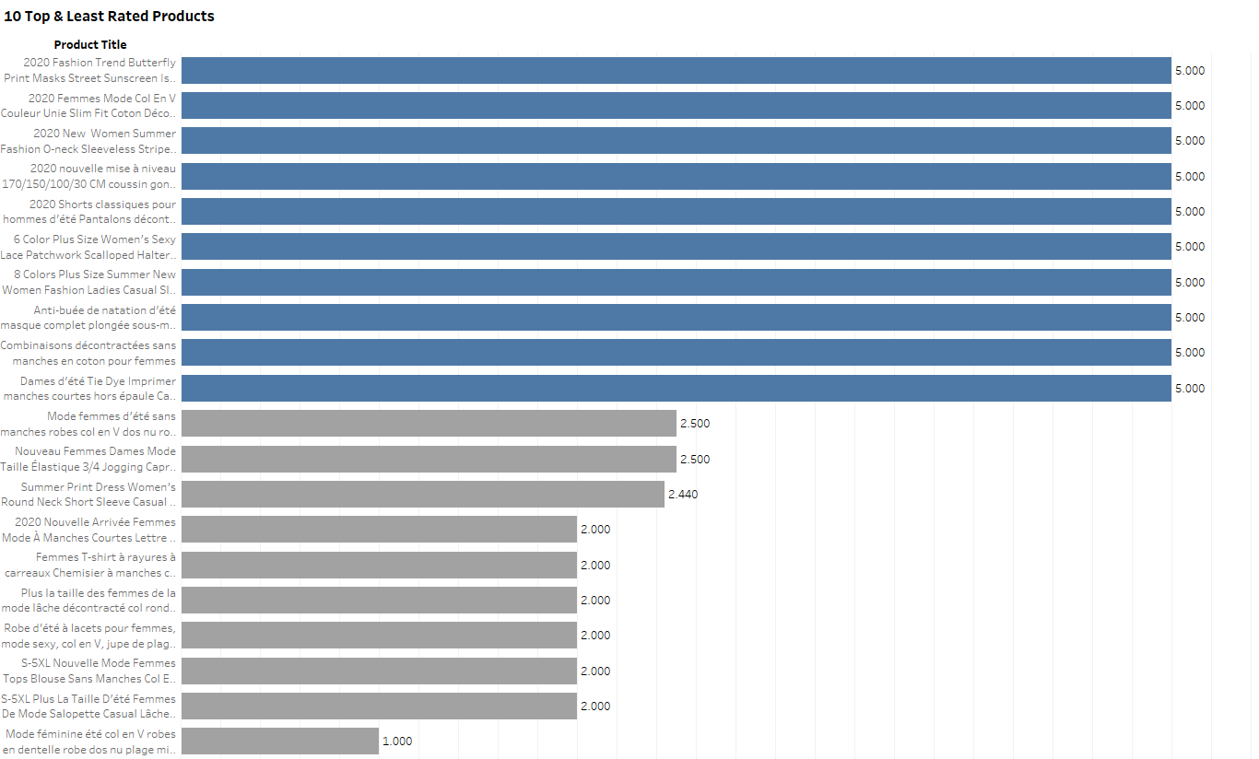
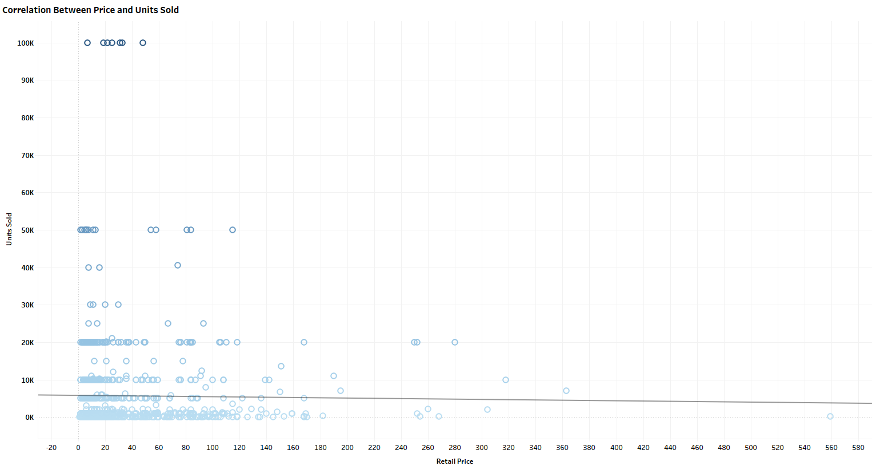
:Insights:
The sheet titled “Product Inventory Analysis for Merchants” gives us a clear picture of the product wise inventory status for each merchant in the provided timeframe. Products are either 50 or 100 in numbers in the Inventory.
This sheet also takes us to the respective product webpages through the URL action of the dashboard which gives us a clearer view to the details of that product.
The second sheet clearly shows us the top and least rated products at a go. We can see few products have been rated as much as 5 and product like “Mode féminine été col en V robes en dentelle robe dos nu plage mini robes sans manches bretelles spaghetti robe blanche grande taille XS-5XL Robe Femme” has been rated even 1 by the customers!
This sheet shows total 20 products, 10 with top ratings and other 10 with the least.
The next interesting sheet titled as ‘Correlation Between Price and Units Sold’ gives us a clear picture how the higher priced products are sold lesser than the lower priced ones. This tells us about the customer sentiment.
The trend line of this sheet is coming up with a negative slope which shows a negative relationship between these two important features. Here the highest sold products are denoted by darker color and vice versa.
Top & Least Rated Products
Relation: Units Sold VS Retail Price

Slide 5
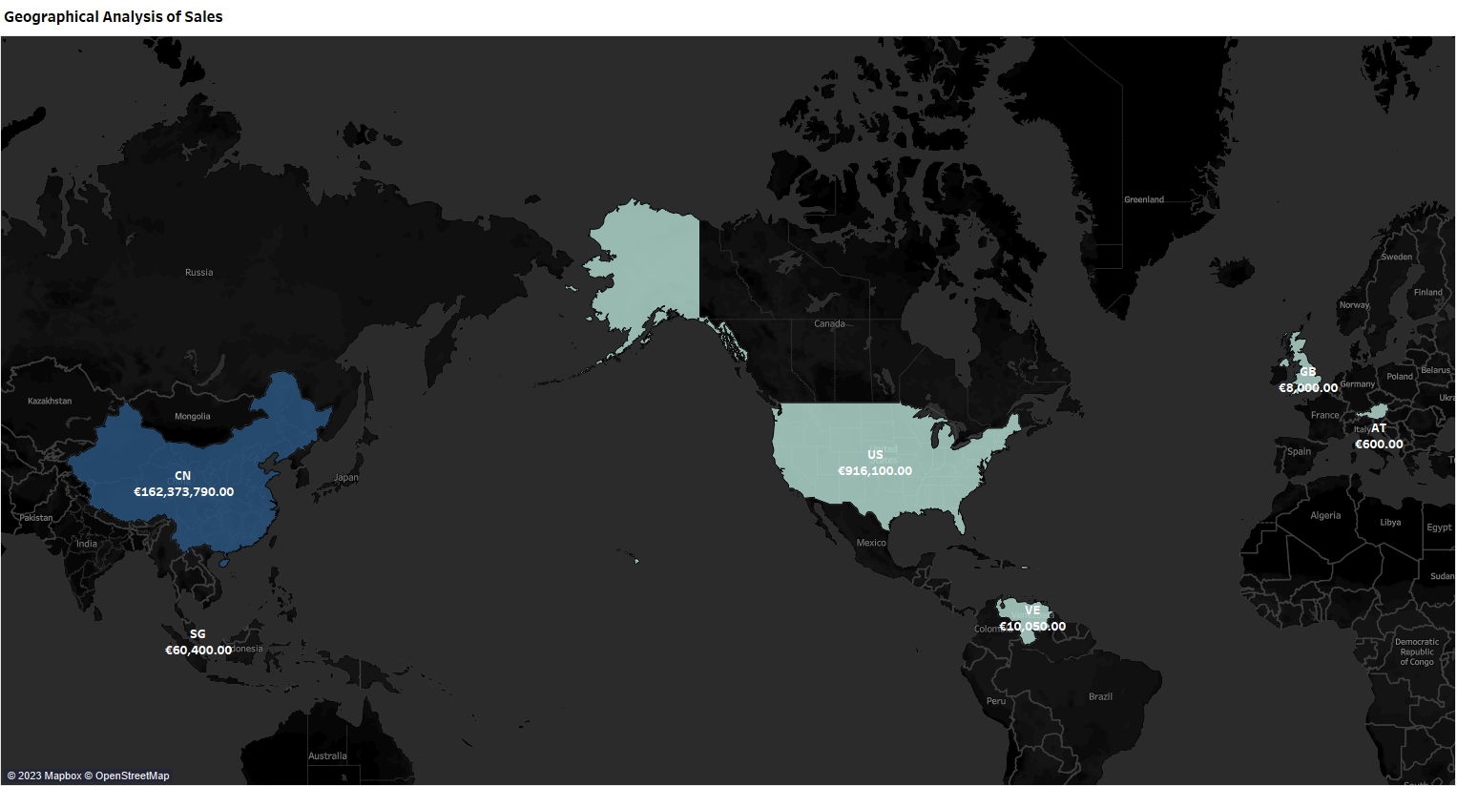
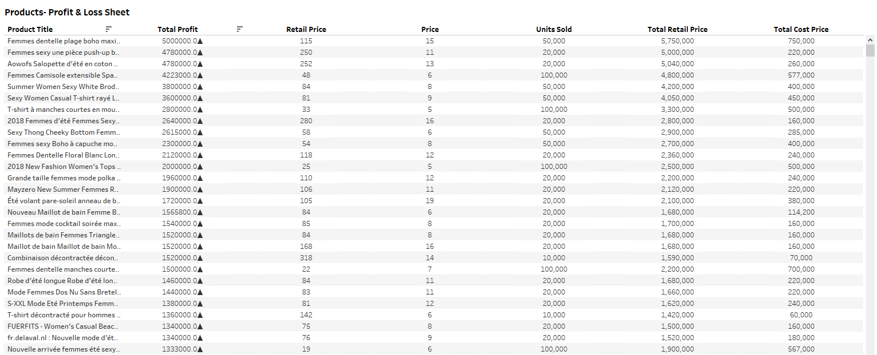
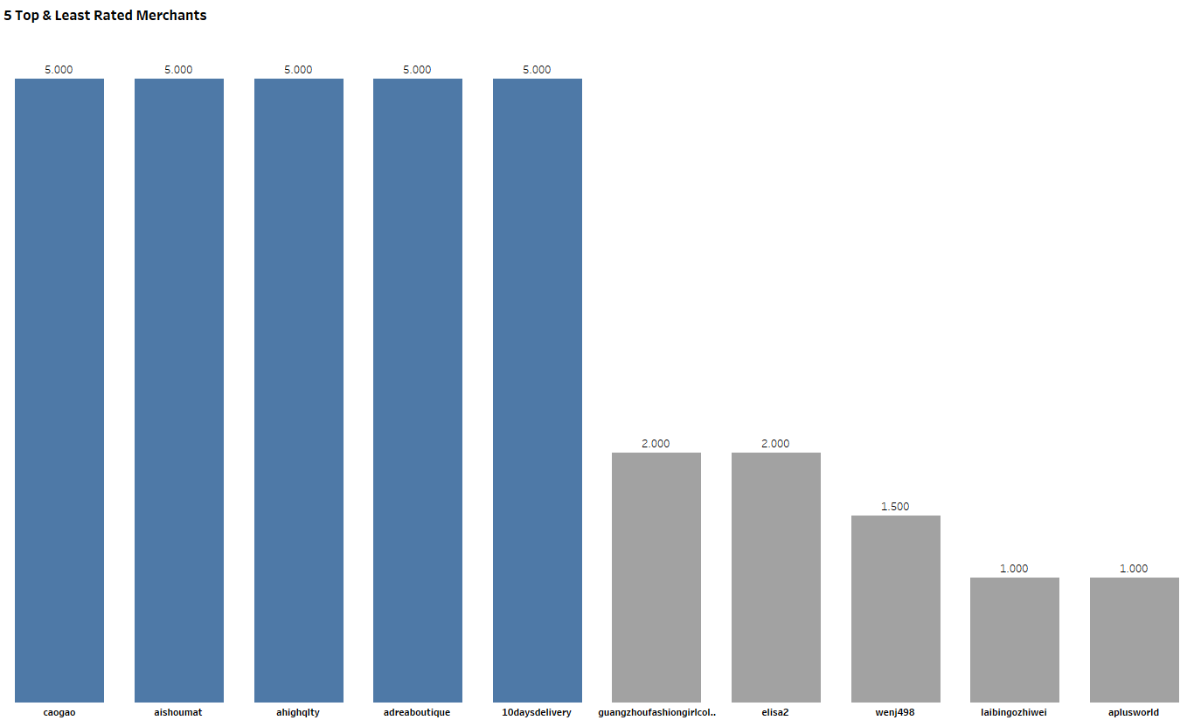
:Insights (Continued):
The next sheet in the dashboard presents a geographical analysis of product sales. As we can see, China is leading the tally with €162,373,790.00 sales followed by the USA with €916,100.00 sales as origination countries.
This map gives us a complete view for the countries originating the products and how successful they are.
Next is a very crucial view with one of a kind “Products – Profit & Loss Sheet”, which gives us a proper view of Product Price, Sold Price, Units Sold and finally the Total Profit generated by each product. As we see descent amount of profit for many, we also detect some losses here, which should be taken care of.
Finally, the last Bar graph gives us a combined view of the Top and the Least rated merchants at a go. Merchants like ‘caogao’, ‘aishoumat’ etc. have performed brilliantly for the customers while the acceptance of ‘laibingozhiwei’, ‘aplisworld’ etc. is questionable!
Geographical Analysis of Sales
The Profit Loss Sheet of Products
Top & Least Rated Merchants

Slide 6
:Conclusion:
Most of the Merchants as well as the Products are doing well in the market generating an awesome revenue for the client.
Few products need serious attention as the performance is quite poor and many are even in losses!
Countries like Great Britain and Austria are generating relatively lesser sales. May be that is a matter to worry for the management.
As the high pricing of products is somehow decreasing the customer interest, it’s time to rethink on the pricing policy.
The products with high sales and high profits can be introduced in different markets to generate more revenue and advertising the same can help on this.
Overall, the performance seems pretty descent, however rooms are there to improve.

